Slide 1
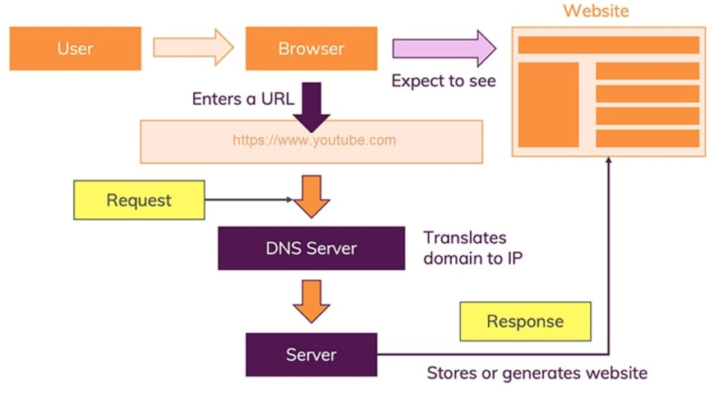
How does the web work?
User opens his laptop (client) that is connected to the internet and opens Google Chrome (browser).
User types in the web address www.youtube.com to the browser address bar
The browser goes to the DNS server and exchange the web address into an IP address.
The browser uses the IP address to make an HTTP request to YouTube's server to access the website page?
YouTube server looks at the HTTP request, prepares the data into packets and TCP numbers each packet.
YouTube server responds with an HTTP response with a "200 OK" status code (means the request was processed successfully) to the user's browser.
TCP assembles the packets back to the data as a whole, and the web page is displayed by parsing HTML, CSS, JavaScript and its assets like images and videos.

Slide 2
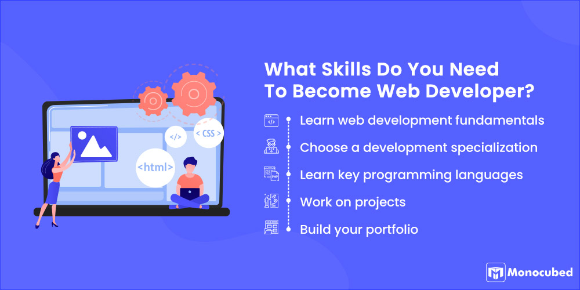
What do you need to be a web developer?
Learn web development fundamentals
The first step to becoming a competent web developer is to start learning web development fundamentals, including an understanding of
HTML (Hypertext Markup Language)
CSS (Cascading Style Sheets)
JavaScript
You can create a lot of basic web applications and websites with just HTML, CSS, and JavaScript coding. So it is important that every developer has a good grasp of these three technologies.
Choose a development specialization
There are mainly 3 kinds of web developers
Frontend developer
Backend developer
Full-stack developer

Slide 3
Learn key programming languages for Web Development
Python
Java
PHP
Ruby
C++
Work on projects to develop your Web Developer skills
Set up a Github account and work on projects. This will also be helpful in adding relevant projects to your resume and help improve your programming skills. An active Github account is always a plus point for a professional web developer. Your Github account will demonstrate what you do to solve issues, your thinking process, and your web development skills.
Build My portfolio
Build my resume, specifying your web development specialty and all the other concepts and tools you have come across and learned while preparing.

Slide 4

Why did you choose to learn web development?
I was chousing to learn web development because :
Web development gives me the opportunity to
express myself creatively on the internet.
I can work from anywhere
Web development is simple and easy to learn
I want to learn Teamwork
There Are Web Dev Jobs Available

